Slide 1
CS521 – Software Project Management Project Presentation
Judith Jane(16019)
Udaya (17182)

Slide 2
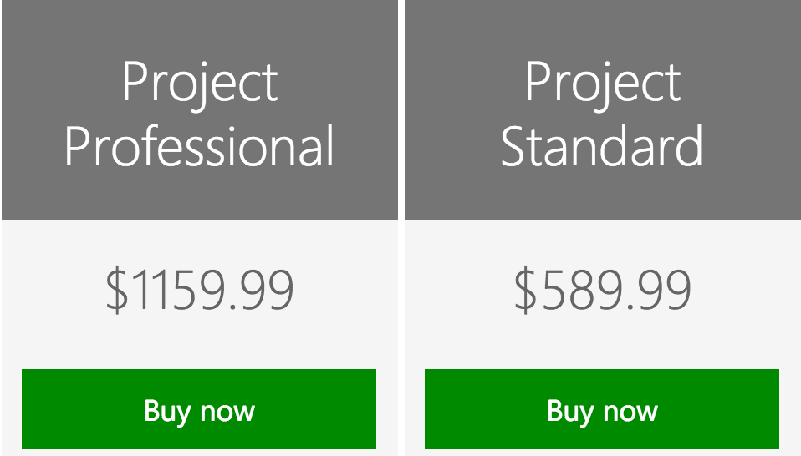
Microsoft Project(MSP):
Project management software program designed to assist a project manager in developing a plan, assigning resources to tasks, tracking progress, managing the budget, and analyzing workloads.
Developed and sold by Microsoft.
2 editions: Cost:
> Standard
> Professional
Latest Version:
> Microsoft Project 2016

Slide 3
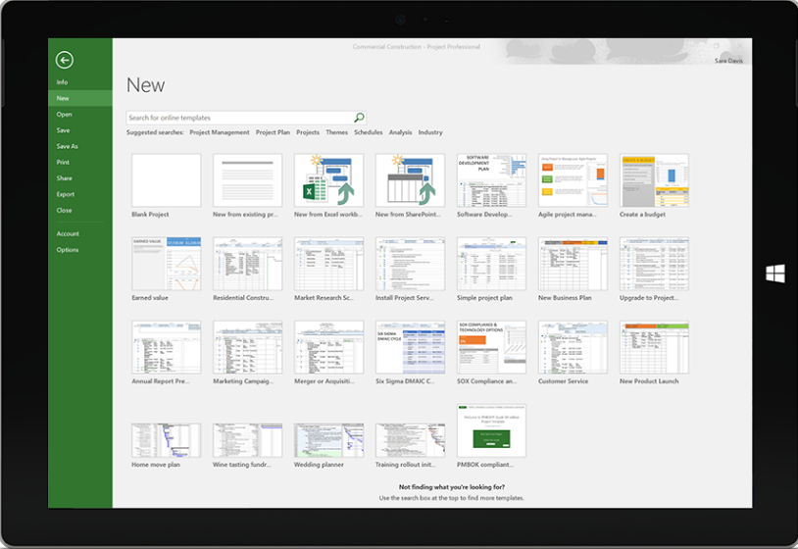
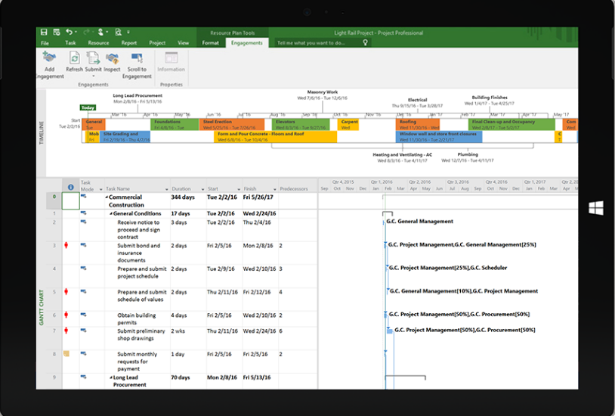
Features of Microsoft Project 2016:
Built-in templates:
Built-in, customizable templates use industry best practices to help you get started on the right path—so there’s no need to create project plans from scratch.
Project planning:
Familiar scheduling features like Gantt charts and prepopulated pulldown menus help reduce training time and simplify the project planning process.

Slide 4
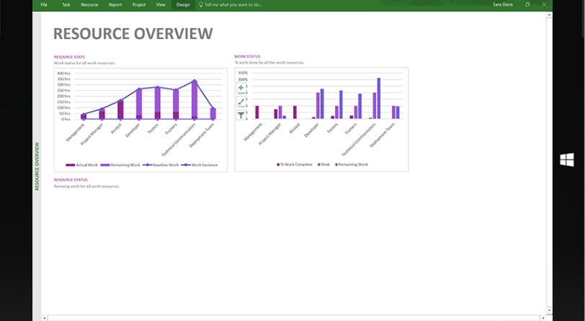
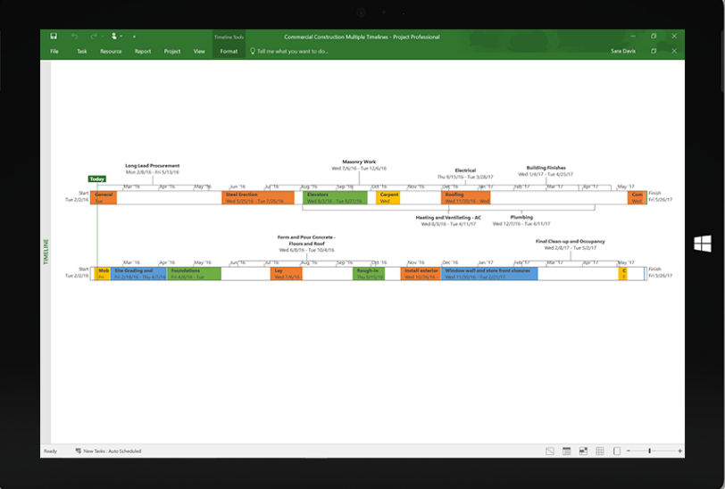
Features of Microsoft Project:
Out-of-the-box reports:
Share reports across your organization to keep everyone on the same page. Reports include everything from burn down charts to financials; and are available across devices.
Multiple timelines:
Quickly view all project activities, from tasks to upcoming milestones. Customize timelines to represent specific data and easily share them with project stakeholders.

Slide 5
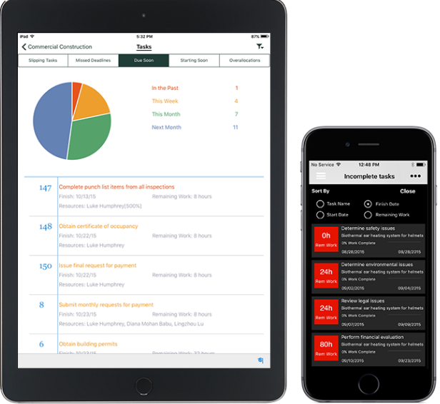
Features of Microsoft Project 2016:
Access across devices:
Microsoft PPM is available on Windows, iOS®, and Android™ devices, so team members can update tasks on their device of choice and view timelines and reports on the go.

Slide 6
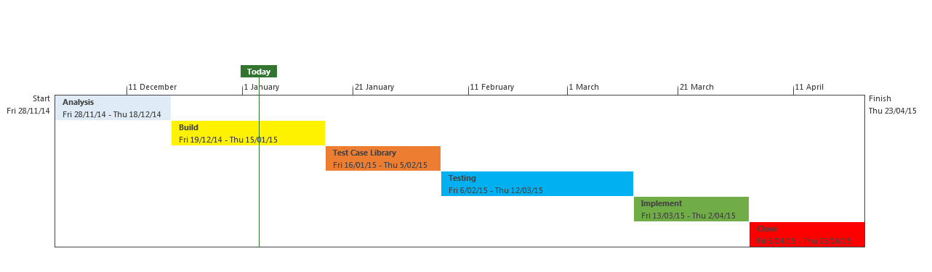
How MSP helps Project Managers:
Timeline view:
The timeline view offers a whole new way of looking at project phases.
It gives the view picture of the project which you can use in presentations to the executive management and the stakeholders.
Colors can be changed for different phases a few formatting options can be selected. We also can display milestones, change the date format and align the tasks.

Slide 7
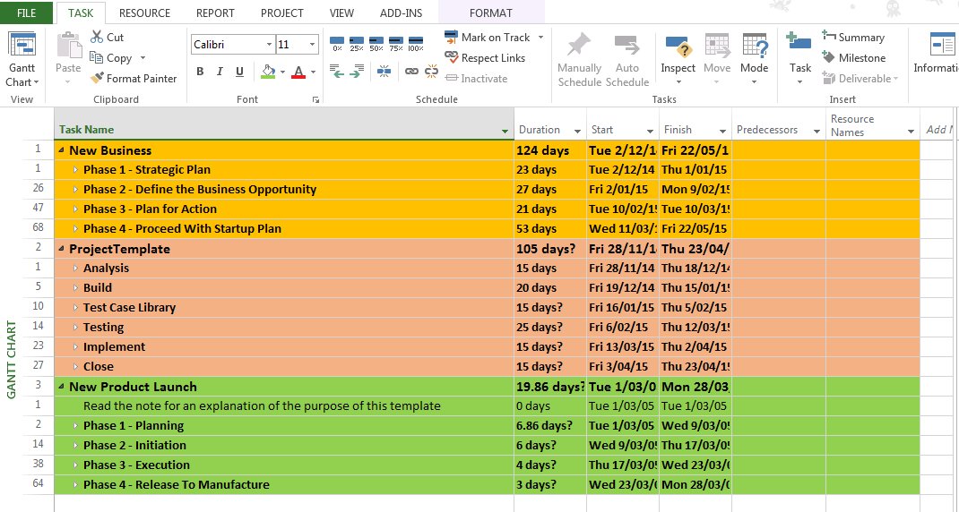
How MSP helps Project Managers:
Manage Multiple Projects:
Master Project plan allows us to combine more different project plans into a single master project plan.
It is very useful concept when you need to track multiple or a portfolio of projects.

Slide 8

How MSP helps Project Managers:
Resource Pool:
Allows different project managers to share a common set of resources.
Allows project managers to identify resourcing conflicts early in the planning phase.
Allows resource information like vacation plans, availability and costs to be defined at a central location. .

Slide 9
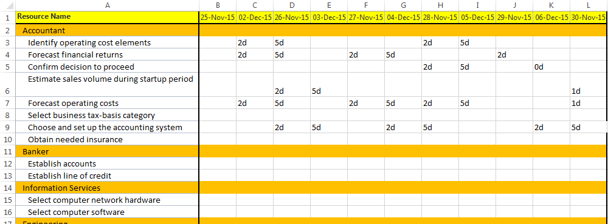
How MSP helps Project Managers:
Team Task Report:
MS Project has resource views which in conjunction with groups can be used to generate task allocation reports for the project team.
Not to mention the basic options for adding resources and maintenance of resources.

Slide 10
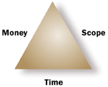
SDLC phases that MSP helps PM:
It helps the Project Managers in the following phases:
Project Initiation
Project Planning
Performance monitoring and cost control
Triple Constraints:
PM maintains a balance between the factors such as scope, cost and time to make the project successful.
Even the smallest change in scope of work will bring imbalance in cost and time; PMs major responsibility is to incorporate the scope change into master plan/schedule to figure out the cost and time variations.
MSP helps tracking of all these factors to make routine checks.

Slide 11
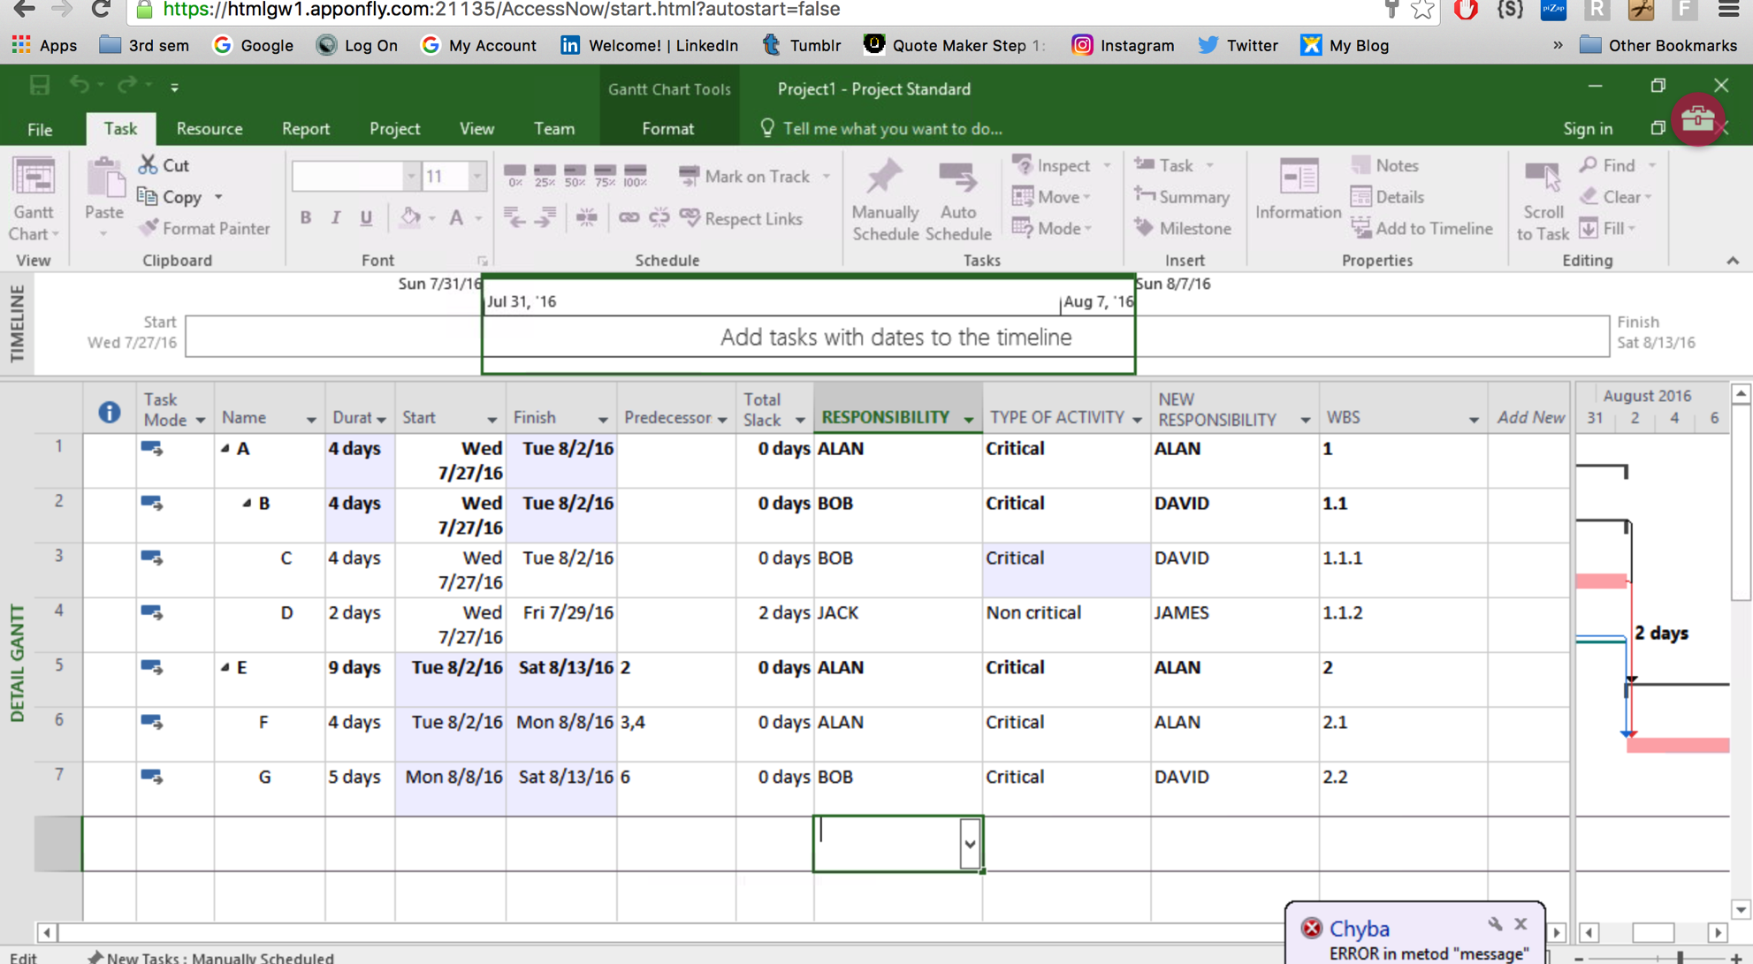
OUTPUT SCREENS:
Work Breakdown Structure(WBS):
A key project deliverable that organizes the team's work into manageable sections.
Project -> components & sub components
Select Activities-> Right Indent

Slide 12
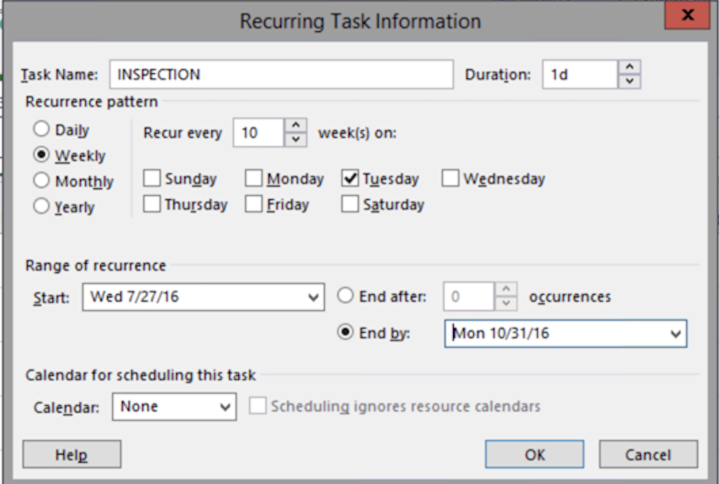
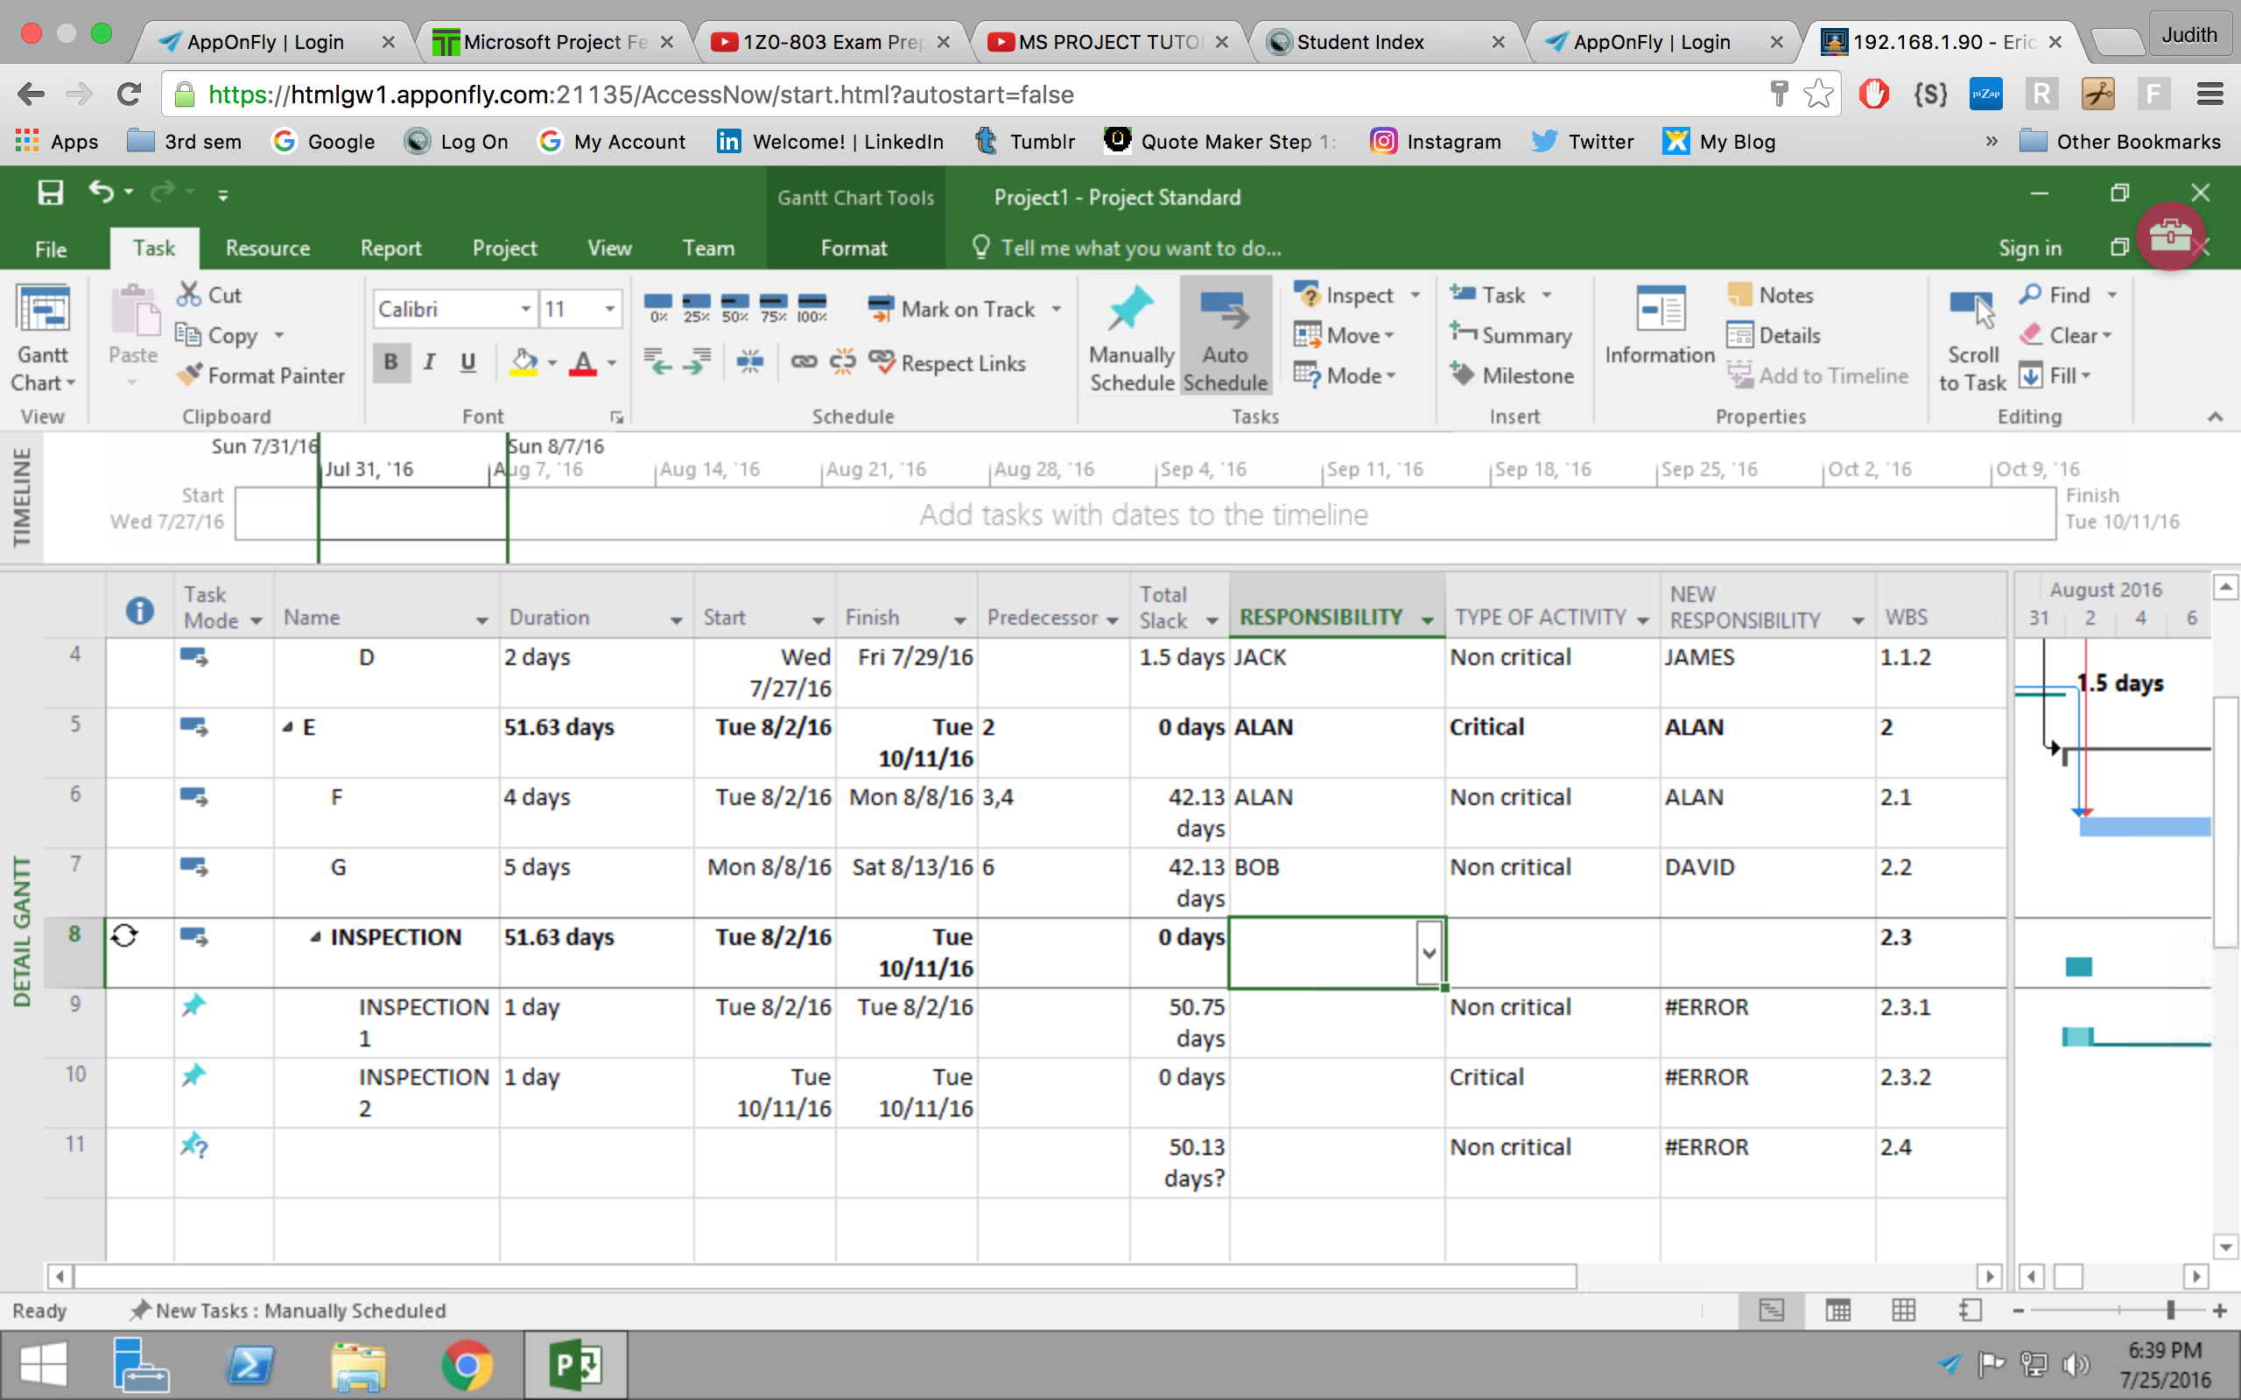
Recurring Activity:
The activities that are repeating can be figured out and automated within specific time intervals, instead of doing it manually every time
Task name: Inspection
Recurrence Pattern: Every Tuesday
Range of Occurrence: From date & To date

Slide 13
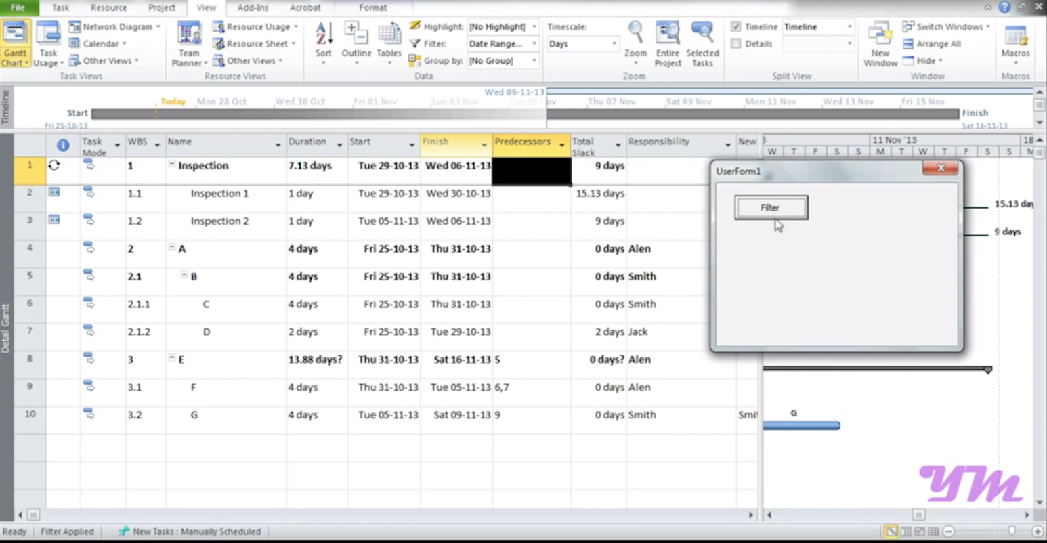
Macros:
A computer program which is used to execute a series of instructions. Usually a macro is utilized for something that is repetitive in nature
Complex calculations that need to be repeated for varied sets of inputs,
A particular action being performed over and over again on different input, files, etc.

Slide 14
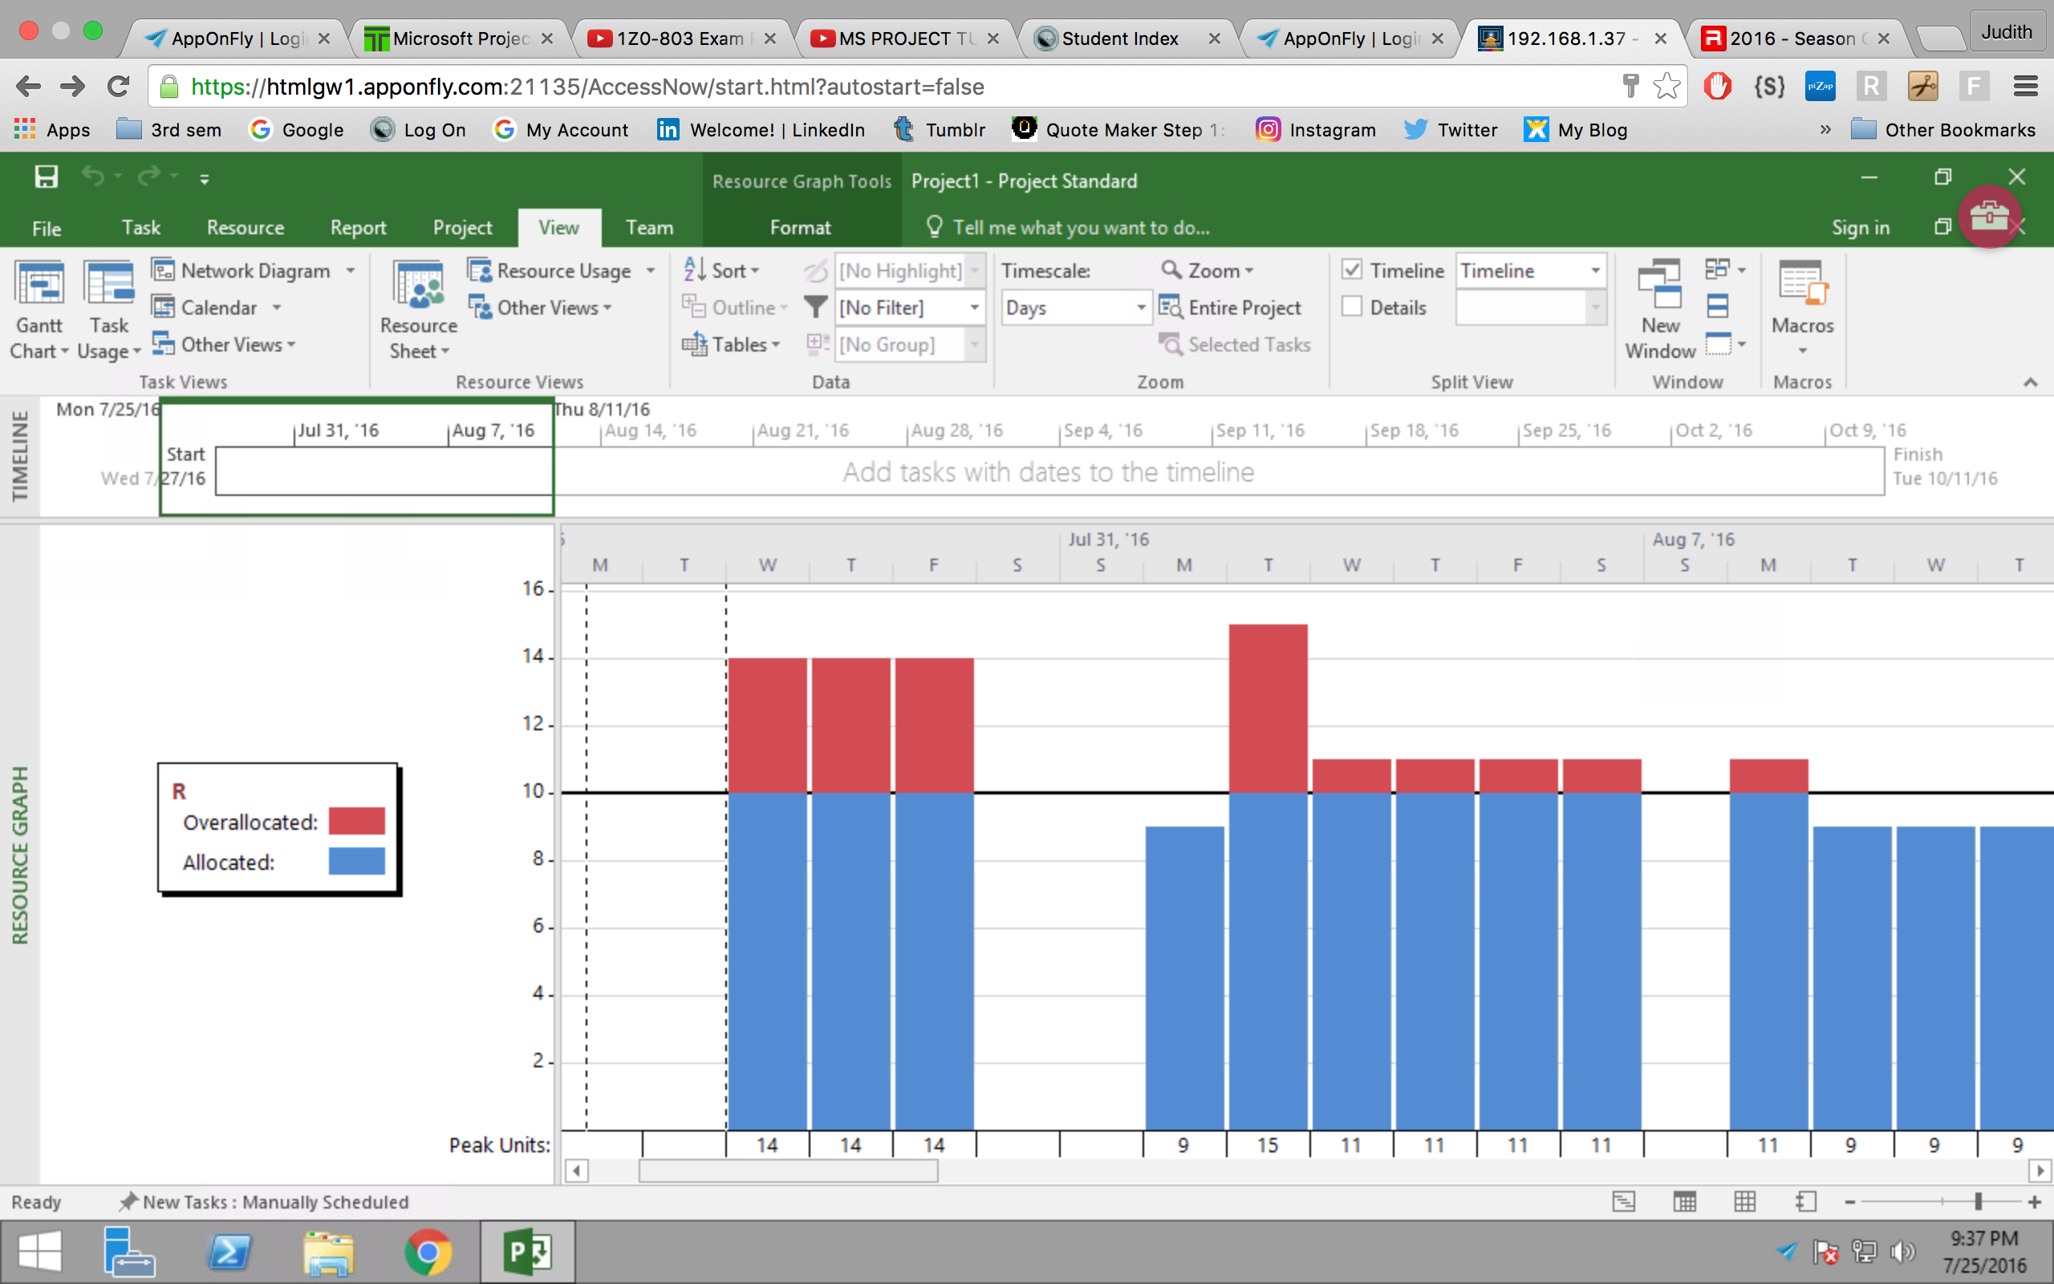
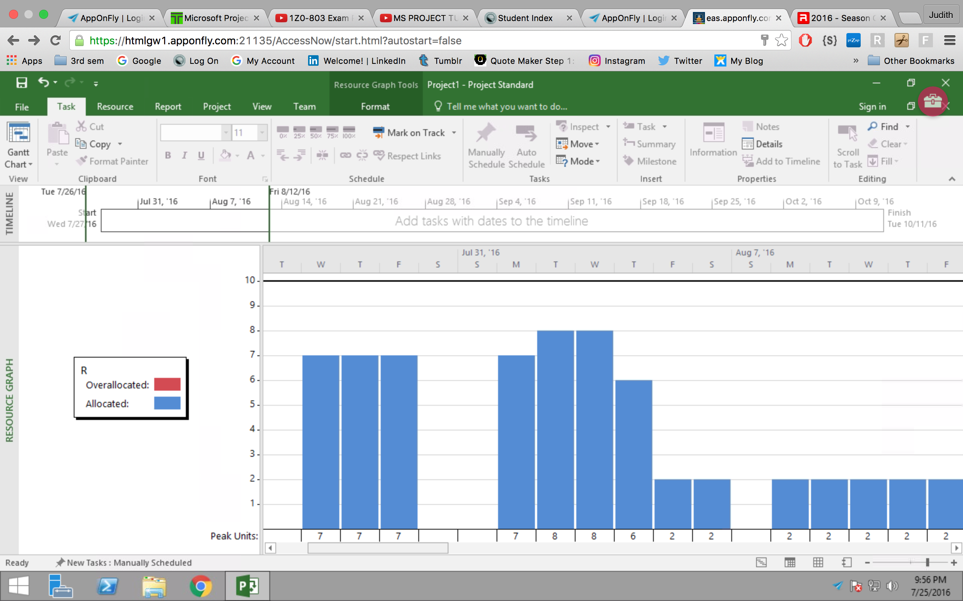
Resource Leveling:
It overlooks resource allocation and resolves possible conflict arising from over-allocation. When project managers undertake a project, they need to plan their resources accordingly. This will benefit the organization without having to face conflicts and not being able to deliver on time.
Resource leveling is considered one of the key elements to resource management in the organization. An organization starts to face problems if resources are not allocated properly i.e., some resource may be over-allocated whilst others will be under-allocated. Both will bring about a financial risk to the organization.

Slide 15
References:
https://www.youtube.com/watch?v=ZIrshh-0s3I
https://products.office.com/en-us/project/project-and-portfolio-management-software
http://www.techno-pm.com/2015/01/5-reasons-why-project-manager-should.html
https://en.wikipedia.org/wiki/Microsoft_Project
https://www.mindtools.com/pages/article/newPPM_03.htm
Thank you..!!

